Slide 1
《SMFL integrating spectrum and mutation for fault localization》 | 2019 | DSA
《Technique of software fault localization based on hierarchical slicing spectrum》 | 2013 | Journal of Software
《HSFal: Effective fault localization using hybrid spectrum of full slices and execution slices》 | 2015 | JSS
《Lightweight fault-localization using multiple coverage types》 | 2009 | ICSE
《Cleansing test suites from coincidental correctness to enhance fault-localization》 | 2010 | ICST
延时符

Slide 2

Cleansing Test Suites from Coincidental Correctness
to Enhance Fault-Localization
作者：Wes Masri
汇报人：陈冰婷
导师：邹卫琴
延时符

Slide 3
PART 01
Why clean test suits?
目录
Contents
PART 02
How to clean test suits?
PART 03
Results
延时符

Slide 4



Why
Coincidental Correctness
1) The defect is executed or reached
2) The program has transitioned into an infectious state
3) The infection has propagated to the output
延时符

Slide 5

What
Motivation
The prevalence of coincidental correctness
Its safety reducing effect on fault localization
延时符

Slide 6
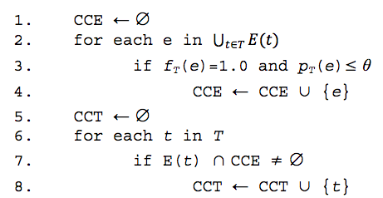
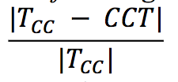
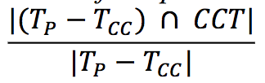
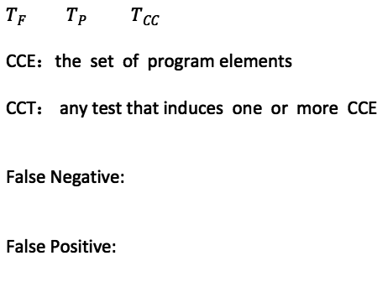
What
Technique-I
$T_{F}$ $T_{P}$ $T_{CC}$
CCE：the set of program elements
CCT： any test that induces one or more CCE
False Negative:
False Positive:
延时符

Slide 7
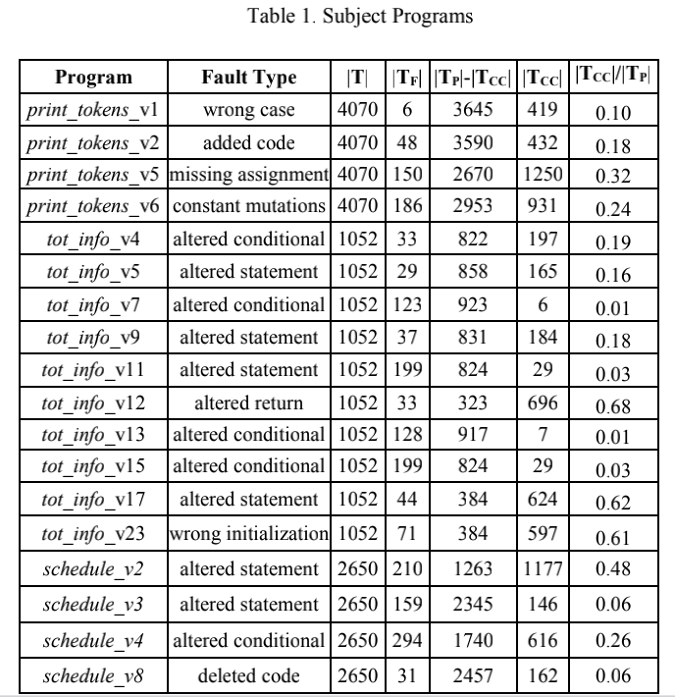
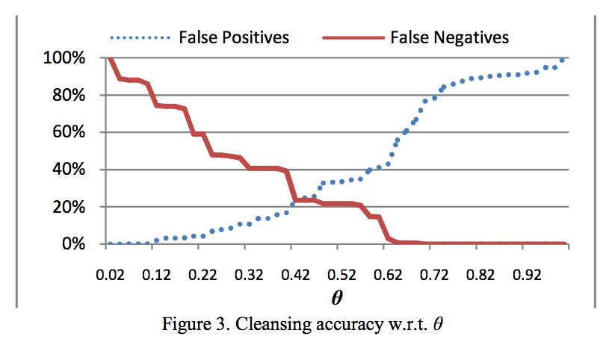
What
Subject Programs
18 seeded versions that are part of the Siemens test suite
延时符

Slide 8
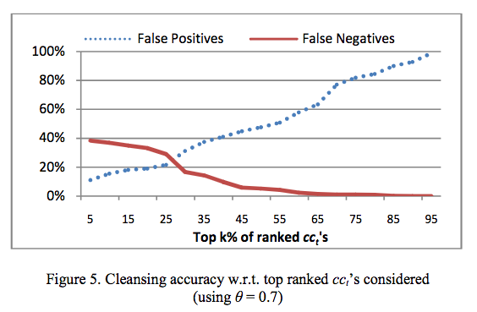
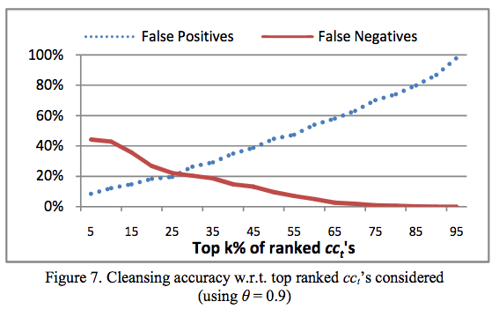
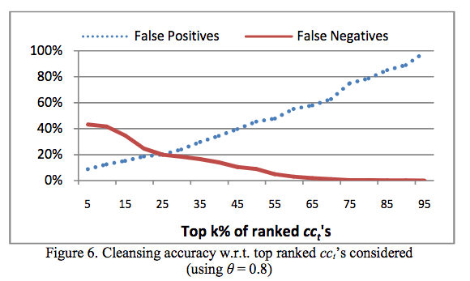
What
Technique-II
Assumption: a cct containing a large number of cce’s and/or cce’s with a high average weight is more likely to be a coincidentally correct test than another that does not.
延时符

Slide 9
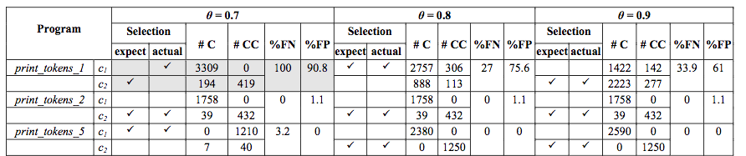
What
Technique-III
Assumption: coincidentally correct tests will cluster together .
K-Means
延时符

Slide 10
What
Comparison
False Negative | Technique I > Technique II > Technique III
Safety | Technique I > Technique II ≈ Technique III
Precision | Technique III > Technique II
延时符

Slide 11
THANK YOU FOR YOUR LISTENING.
谢谢您的聆听

